Slide 1





Organization Name | B P College of Computer Studies, Gandhinagar.
Problem Statement Title | Buyers - Sellers Connection and Government Scheme information through individual or village councilor.
Team Name | Hack Geniuses
Team Leader Name | Chaudhari Urvi Prahlad bhai
Institute Name | B P College of Computer Studies, Gandhinagar.

Slide 2

Sr. No. | Name of the Team Member | Branch | Year | Position/Role in team
1 | CHAUDHARI URVI PRAHLADBHAI | BCA | 2nd Year | Team Leader / Research
2 | NIMAVAT MEET NILESHBHAI | BCA | 2nd Year | Co-Leader / Front End
3 | DHORIYANI HARSH HASMUKHBHAI | BCA | 2nd Year | Front end
4 | MIRANI SMIT MAHESHBHAI | BCA | 2nd Year | Designing
5 | BARAD JEET MANOJBHAI | BCA | 1st Year | Designing
6 | TERAIYA VAIDEHI KIRITBHAI | BCA | 1st Year | Front End
Sr. No. | Name of mentor | Category | Expertise | Domain Experience
1 | Prof. Girish Dave | Mentor | AI & ML (Web Development) | Web
2 | Mr. Chandresh Patel | Co-Mentor | (Web Development) | Web

Slide 3
IDEA TITLE
Proposed solution :
Field Bridge is a comprehensive platform designed to empower farmers and buyers by providing Easy platform access.
Real-time data and weather updates for farmers.
Multilingual support in Gujarati and Hindi.
Streamlined Communication channels.
Increased Awareness of government policies, fostering informed decision-making.
Uniqueness of Project :
Real time weather report.
Government agriculture policies awareness.
Direct market access without mediator.
Supports 2 languages.
Farmer sell products all over state or country.

Slide 4
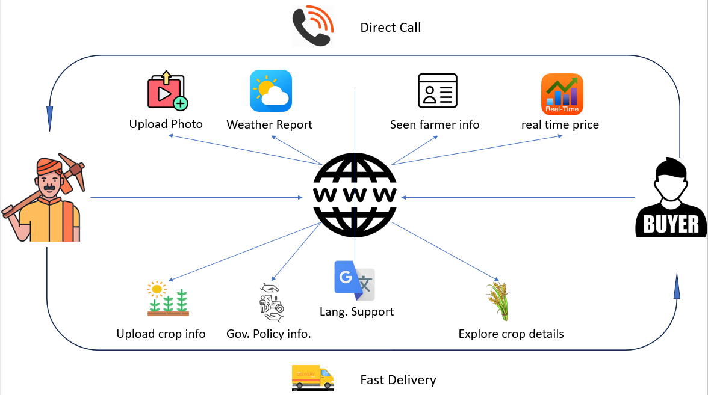
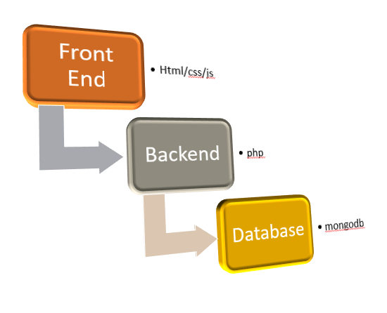
Working Flow
Tech Stack

Slide 5
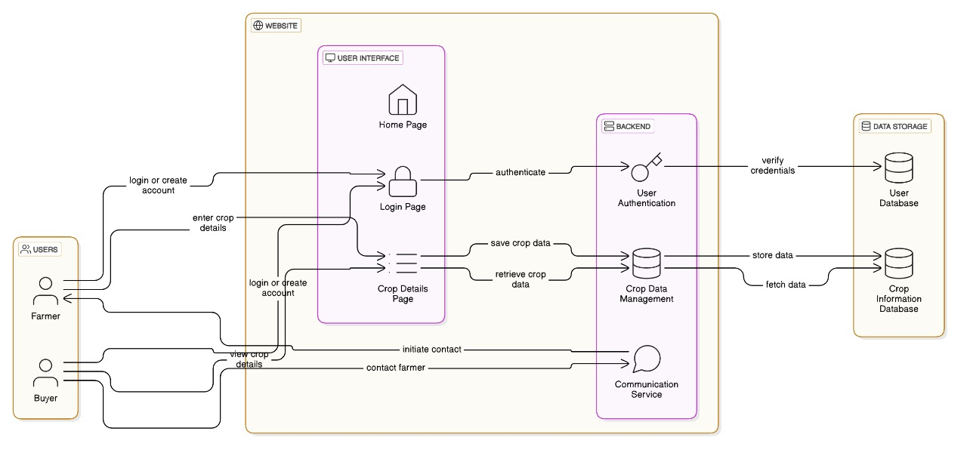
Architecture

Slide 6

Benefits :
Current Problem
Our Solution
Boosts farmers' earnings by providing fair market access and better pricing.
Equips farmers with real-time data and insights for smarter agricultural planning.
Ensures easy platform access for farmers and buyers across diverse regions and demographics.
Facilitates direct communication, fostering trust and long-term partnerships.
Strengthens rural economies by connecting farmers to broader markets and opportunities.
Problem | Solution
* Farmer can’t get their fair price of crop​. | * We can connect farmer to buyer directly without mediator​.
* Farmer cannot take benefits of government policies​. ​ | * We can inform and create a page which give information about government policies​.
* Many farmer had problem of digital literacy.​ | * Farmer can contact to village councilor​.
* Current agriculture apps can’t give information about weather.​ | * Our website give real-time weather report​.

